Slide 1
Letters from the Lighthouse
Reading Slides

Slide 2
Friday 8th January
Tasks
1. Read Chapter 1 Vocab slides
2. Read Chapter 1

Slide 3
Keep Calm and Carry on
1. Chapter 1 – Vocab Slides

Slide 4



Luftwaffe
NOUN: German airforce until the end of WWII.
SYNONYMS: N/A
EXAMPLE:P1 All month the Luftwaffe had been attacking us, their bombs falling on London like pennies from a jar...

Slide 5
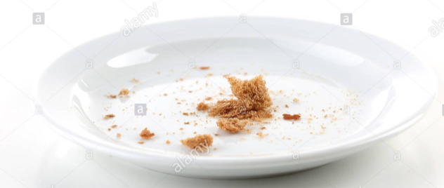
measly
ADJECTIVE: small or few (negative)
SYNONYMS: lamentable,meagre,
EXAMPLE:P1 ...they couldn’t hold off for just a few measly hours...

Slide 6
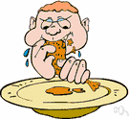
relished
NOUN: great enjoyment,
pleasurable anticipation.
SYNONYMS: enjoyed, appreciated.
EXAMPLE:P1 And Cliff relished gory details, being the sort who’d pick scabs off his knee just to see what was underneath.

Slide 7

gory
ADJECTIVE: showing bloodshed
SYNONYMS: savage, brutal, gruesome.
EXAMPLE:P1 And Cliff relished gory details, being the sort who’d pick scabs off his knee just to see what was underneath.

Slide 8
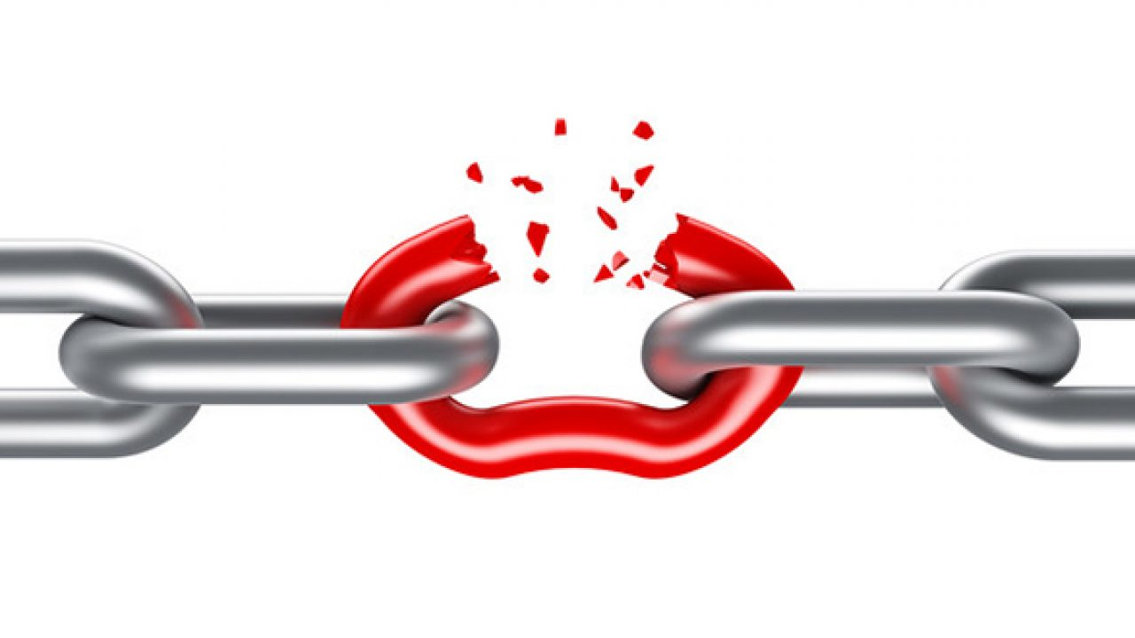
flaw
NOUN: not perfect.
SYNONYMS: fault, defect, imperfect.
EXAMPLE: P2 ...like it was the biggest character flaw in the world.

Slide 9
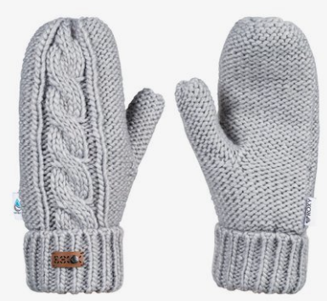
mittens
NOUN: A glove with two sections, one for the thumb the other for all four fingers.
SYNONYMS: gloves
EXAMPLE: P3 Cliff’s mittens, on string threaded through his coat, dangled limp at the end of his sleeves.

Slide 10

maroon
ADJECTIVE: reddish/brownish colour
SYNONYMS: dark reddy-brown
EXAMPLE: P4 - when the great maroon curtains swung apart with a squeak.

Slide 11

Pathe
Noun: TV company/programme.
SYNONYMS: N/A
EXAMPLE: P4 I watched eagerly, chin in hand, as the big white titles and the word ‘Pathe’ filled the screen.

Slide 12

lav
Noun: toilet
SYNONYMS: toilet, wc, loo
EXAMPLE: P4 ‘She needs the lav,’ Cliff said knowingly.

Slide 13

jarred
VERB: painful or uncomfortable shock
SYNONYMS: shocked
EXAMPLE: P5 The Pathe news voice - jolly and brisk - jarred with what I was seeing.

Slide 14
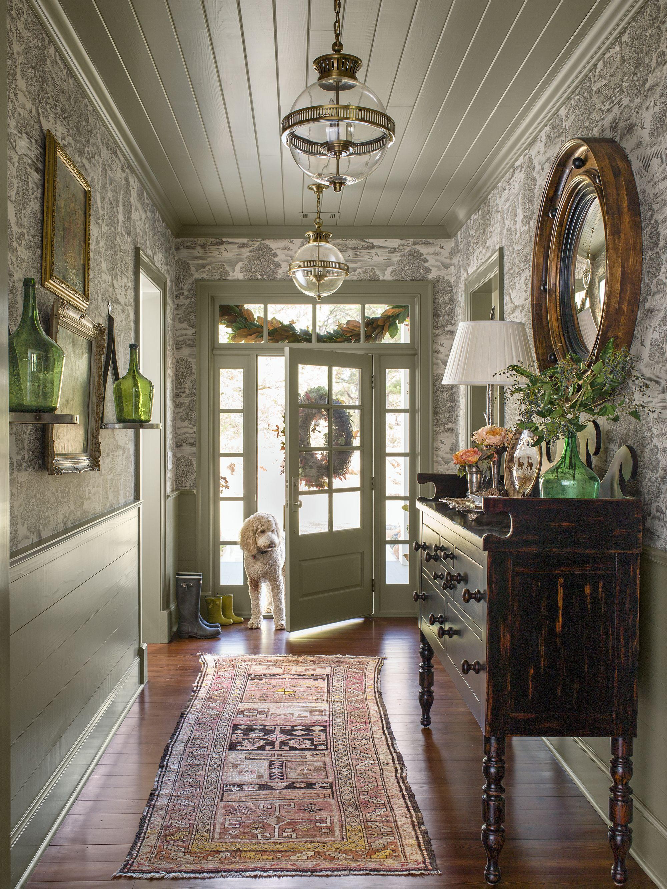
foyer
NOUN: entrance hall to a public building.
SYNONYMS: hall way, reception area, lobby
EXAMPLE: P7 In the foyer, the lights were off.

Slide 15

dithering
VERB: to be indecisive
SYNONYMS: hesitate, loiter
EXAMPLE: P8 ‘What you dithering for?’ I tried to explain: ‘My sister’s in the toilet.’

Slide 16
random
ADJECTIVE: a happening done without method or conscious decision.
SYNONYMS: haphazard chance, accidental
EXAMPLE: P11 A silly, random thought came to me...

Slide 17
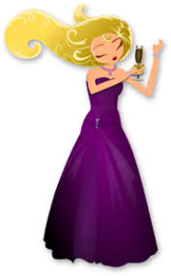
Glammed up
ADJECTIVE: excessively applied make-up.
SYNONYMS: made-up, dolled-up
EXAMPLE: P12 It was probably why she had got glammed up in the first place.

Slide 18

flitted
VERB: short, quick movement
SYNONYMS: passed/moved quickly
EXAMPLE: P12 A strange look flittered over her face.

Slide 19
droned
VERB: a low, continuous humming sound
SYNONYMS: hummed, buzzed, whirred
EXAMPLE: P13 As more planes droned overhead, she glanced worriedly at the sky.

Slide 20

disorientated
VERB: lose sense of direction
SYNONYMS: confused, muddled
EXAMPLE: P13 A minute passed or it might’ve been an hour. I was too disorientated to be sure.

Slide 21
2. Now read Ch1: Keep Calm and Carry on
..

